Slide 1
Architectural patterns

Slide 2
Architectural patterns
Patterns:
a way of representing, sharing and reusing knowledge about software systems.
described using narrative descriptions or diagrams.
Must include the pattern’s strength and weaknesses.
Pattern description include:
Pattern name
Brief description
Graphical model
Example of a relevant system where that pattern have already been used.
When to use that pattern , pros & cons of the pattern.
The fundamental idea behind arch. is separation and independence. Because it is beneficial for incorporating the localized changes only.
We will discuss some widely used architectural patterns.

Slide 3
MVC
Split application into multiple sections all have own purpose
User sent request to controller
Controller being the middle man between model and view, process the client request and sent to Model
Model handles data logic, access database and do authentication/update/delete or whatever is needed to perform on data.
Controller pass the raw information received from model to view
View presents the data
Return to controller and controller send response to client
This is a way to segregate data presentation from data logic.

Slide 4
The Model-View-Controller (MVC) pattern
Name | MVC (Model-View-Controller)
Description | Separates presentation and interaction from the system data. MVC divides application into 3 parts. (Separation of concerns) The Model component manages the system data and associated operations on that data. The View component defines and manages how the data is presented to the user. The Controller component manages user interaction (e.g., key presses, mouse clicks, etc.) and passes these interactions to the View and the Model.
Example | A figure in successive slides shows the architecture of a web-based application system organized using the MVC pattern.
When used | Used when: there are multiple ways to view and interact with data. the future requirements for interaction and presentation of data are unknown.
Advantages | Allows the data to change independently of its representation and vice versa. (adding a new view or changing an existing one might not affect the underlying data in model) Supports multiple presentation of the same data (changes made in one representation reflected in all of them.)
Disadvantages | Can involve additional code and increase code complexity.

Slide 5
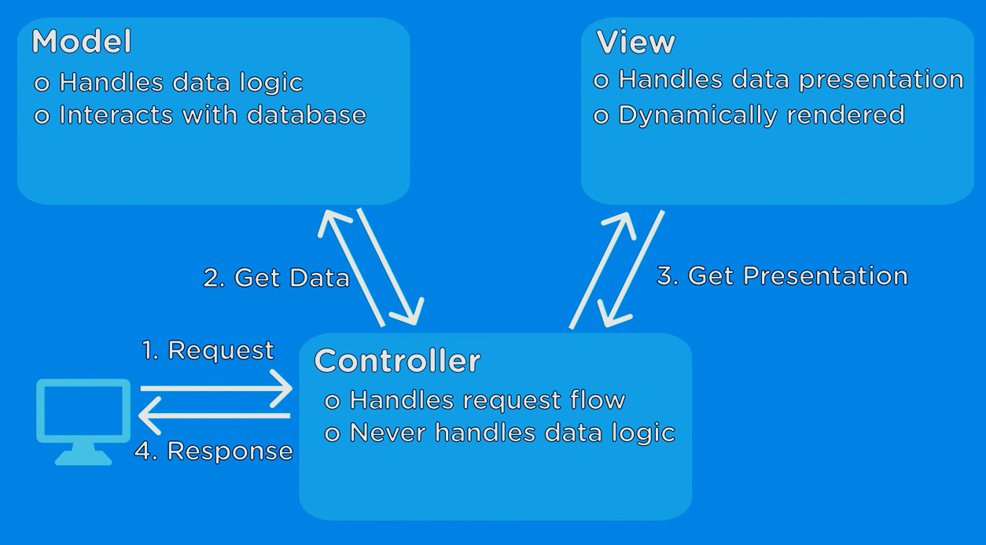
The organization of the Model-View-Controller

Slide 6
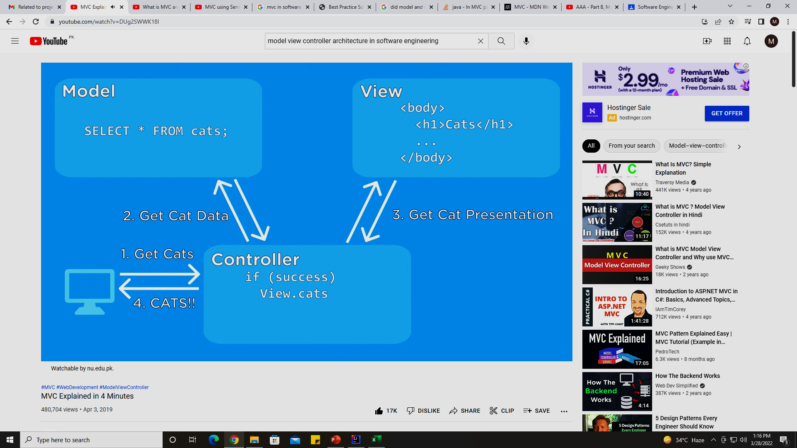
Example of MVC based web application

Slide 7

Example of MVC based web application

Slide 8
Layered architecture
Organises the system functionality into a set of layers each of which provide a set of services.
Typically layers are UI, Auth & Authorization, Business logic, OS / DB
Every layer relies on facilities and services offered by the layer immediately beneath it.
Upper layer talk to layer below that, no jumping between layers is allowed
Lower layers never called to upper layer they just replied to the inputs from upper layer
Requesting something from a layer means iterating down to multiple layers
Structuring tasks into teams is easy as multiple teams may work for different layers.

Slide 9
Layered architecture
Advantages:
Easy to embed NFRs like security by inserting a layer without disrupting the whole system i.e., build on top approach
When a layer is updated, then only the adjacent layer is affected.
Easy to support multi platform applications as only the machine dependent layers need some changes to support multi OS or databases.
Module replacement or upgradation is easy
Disadvantages:
performance is an issue as a request has to go over multiple layers for a reply
Its really difficult to code, like avoid going to specific layers
(creating this level of independence between layers).

Slide 10
The Layered architecture pattern
Name | Layered architecture
Description | Organizes the system into layers with related functionality associated with each layer. A layer provides services to the layer above it so the lowest-level layers represent core services that are likely to be used throughout the system.
Example | A layered model of a system for sharing copyright documents held in different libraries.
When used | Used when: building new facilities on top of existing systems; development is spread across several teams with each team responsibility for a layer of functionality; There is a requirement for multi-level security.
Advantages | Allows replacement of entire layers so long as the interface is maintained. Redundant facilities (e.g., authentication) can be provided in each layer to increase the dependability of the system.
Disadvantages | In practice, providing a clean separation between layers is often difficult and a high-level layer may have to interact directly with lower-level layers rather than through the layer immediately below it. Performance can be a problem because of multiple levels of interpretation of a service request as it is processed at each layer.

Slide 11
A generic layered architecture

Slide 12
The architecture of the iLearn system case study

Slide 13
Repository architecture
Sub-systems must exchange data.
This may be done in two ways:
Shared data is held in a central database or repository and may be accessed by all sub-systems.
Each sub-system maintains its own database and passes data explicitly to other sub-systems.
When large amounts of data are to be shared, the repository model of sharing is most commonly used a this is an efficient data sharing mechanism.
It’s a static structure, doesn’t change at runtime. (difference from client-server architecture).

Slide 14
The Repository pattern
Name | Repository
Description | All data in a system is managed in a central repository that is accessible to all system components. Components do not interact directly, only through the repository.
Example | Examples are: Interactive Development Environment for softwares, MIS etc.
When used | When: large volumes of information are generated that has to be stored for a long time. In data-driven systems where the inclusion of data in the repository triggers an action or tool.
Advantages | Components can be independent—they do not need to know of the existence of other components. Changes made by one component can be propagated to all components. All data can be managed consistently (e.g., backups done at the same time) ~ central repository
Disadvantages | The repository is a single point of failure so problems in the repository affect the whole system. Distributing the repository across several computers may be difficult.

Slide 15
A repository architecture for an IDE

Slide 16
Client-server architecture
Runtime organization of distributed systems
A set of services mounted over associated servers and client access the services via servers.
Components:
A set of Servers: print server, file server, management server etc.
A set of clients: different instances of a client program running concurrently on multiple machines to access service offered by server.
Network: distributed system architecture using internet protocols
Client access services offered by servers via remote procedure invocation using request-reply protocols.

Slide 17
The Client–server pattern
Name | Client-server
Description | In a client–server architecture, the functionality of the system is organized into services, with each service delivered from a separate server. Clients are users of these services and access servers to make use of them.
Example | Next figure shows example of a film and video/DVD library organized as a client–server system.
When used | Used when: data in a shared database has to be accessed from a range of locations. May also be used when the load on a system is variable.
Advantages | Resource sharing Independent servers No single point failure transparent system upgradation
Disadvantages | Each service is a single point of failure so susceptible to denial of service attacks or server failure. Performance may be unpredictable because it depends on the network as well as the system. May be management problems if servers are owned by different organizations.

Slide 18
A client–server architecture for a film library

Slide 19
Pipe and filter architecture
Functional transformations process their inputs to produce outputs (that’s why its called as filter).
May be referred to as a pipe and filter model (as in UNIX shell).
Variants of this approach are very common. When transformations are sequential, this is a batch sequential model which is extensively used in data processing systems.
Best for batch processing, embedded systems or systems with limited user interactions.
Not really suitable for interactive systems because the input data stream needs to be pre-processed. GUI based I/O systems have complex input streams like mouse click events, for which converting into sequential in out stream is challenging.

Slide 20
The pipe and filter pattern
Name | Pipe and filter
Description | The processing of the data in a system is organized so that each processing component (filter) is discrete and carries out one type of data transformation. The data flows (as in a pipe) from one component to another for processing.
Example | Coming figure is an example of a pipe and filter system used for processing invoices.
When used | Commonly used in data processing applications (both batch- and transaction-based) where inputs are processed in separate stages to generate related outputs. Compilers. The consecutive filters perform lexical analysis, parsing, semantic analysis, and code generation
Advantages | Easy to understand and supports transformation reuse. Workflow style matches the structure of many business processes. Evolution by adding transformations is straightforward. Can be implemented as either a sequential or concurrent system.
Disadvantages | The format for data transfer has to be agreed upon between communicating transformations. Each transformation must parse its input and unparsed its output to the agreed form. This increases system overhead and may mean that it is impossible to reuse functional transformations that use incompatible data structures.

Slide 21
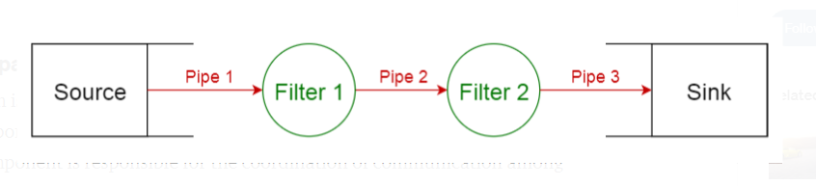
pipe and filter architecture

Slide 22
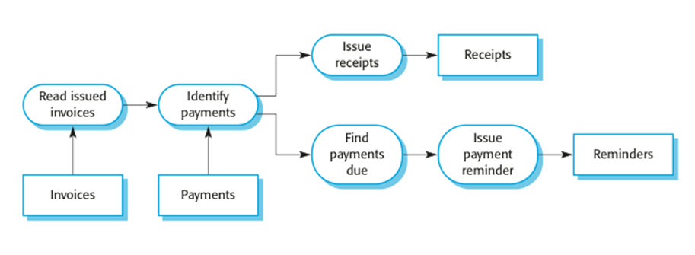
An example of the pipe and filter architecture used in a payments system

Slide 23
Application architectures

Slide 24
Previous review
describes the patterns and techniques used to design and build an application
The architecture gives you a roadmap and best practices to follow when building an application, so that you end up with a well-structured application.
Software design patterns can help you to build an effective application.

Slide 25
Application architectures
Application systems are designed to meet an organizational need.
Somethings are common in all business like hiring people, invoice issuance, keep accounts etc.
That’s why their system have much requirements in common
For example, all phone companies need systems to connect & meter calls, manage network, issue bills to customers.
That’s why multiple phone companies tend to have a generic architecture on which they add their customized requirements to make their product.
A generic application architecture is an architecture for a type of software system that includes principle characteristics of a class of systems.
For e.g., real time systems might have generic arch. Models of different systems like data collection system, data monitoring system etc.
A system for supply chain management can be adapted for different suppliers, different goods, and contracts.

Slide 26
Use of application architectures
As a starting point for architectural design.
If you are unfamiliar with the type of application you are developing then chose a baseline generic architecture and add your features into that to take it to final design.
As a design checklist.
As a way of organizing the work of the development team.
As a means of assessing components for reuse.
As a vocabulary for talking about application types.

Slide 27
Examples of application types
Data processing applications
Data driven applications that process data in batches without explicit user intervention during the processing.
Transaction processing applications
Data-centered applications that process user requests and update information in a system database.
Event processing systems
Applications where system actions depend on interpreting events from the system’s environment.
E.g., trigger an alarm in system on some sensor input etc.
Language processing systems
Applications where the users’ intentions are specified in a formal language that is processed and interpreted by the system.

Slide 28
Application type examples
Two very widely used generic application architectures are transaction processing systems and language processing systems.
Transaction processing systems (web based business systems)
E.g., interactive banking systems, E-commerce systems, information systems & booking systems.
Language processing systems (software development rely on these systems)
Users’ intentions fed in as a formal language like any Programing Language.
They process the language into internal format and depicts as internal representation.
They are also used to interpret command languages like XML
E.g., Compilers (HLL to machine code)

Slide 29
Transaction processing systems
Database centered applications
Process user requests for information from a database or to update the database.
It’s the most common type of interactive business systems
Technically, transaction is a sequence of operation treated as atomic operation to ensure consistency in case of failure of a transaction.
All operations in a transaction must be completed before database changes are made permanent.
From a user perspective a transaction is:
Any coherent sequence of operations that satisfies a goal;
For example - find the times of flights from Karachi to Dubai.
Users make asynchronous requests for service which are then processed by a transaction manager.

Slide 30
The structure of transaction processing applications
User makes request using I/O component
Request process by some application specific logic
A transaction created and passed to transaction manager for processing.
After successful transaction completion, a message is passed to application logic

Slide 31
The pipe and filter architecture of an ATM system
Transaction processing system could be modelled as pipe & filter architecture with system components responsible for input, processing & output.
System composed of two cooperating software components: ATM and Processing logic
Input output components are the installed software components in ATM whereas Process is the software component in Bank’s database server.

Slide 32
Information systems architecture
Transaction processing systems provide information to Information systems for decision making. IS usually generate reports
These include transaction processing systems, as interaction with these systems generally involves database transactions.
Layers include:
The user interface
User communications , Authentication & Authorization ~ pass all user queries & check validations
Information retrieval ~ application logic for accessing & updating data
System database

Slide 33
Generic Architecture of information system
Generic architecture
Often implemented using a distributed with multi tier client-server architecture
Segregated to web server (top most layer), application server (mid 2 layers) and the Database server (for bottom layer)

Slide 34
The architecture of the a Mentcare application
Browser based UI
Components that allow login, authorization, form to present data to user, validation to check data consistency
Implement core system functionalities
Data storage

Slide 35
Web-based information systems
Information and resource management systems are now usually web-based systems where the UIs are implemented using a web browser.
For example, E-commerce systems are Internet-based resource management systems that accept electronic orders for goods or services and then arrange delivery of these goods or services to the customer.
In an e-commerce system, the application-specific layer includes
additional functionality supporting a ‘shopping cart’, add multiple items in separate transactions but pay using 1 transaction at end.

Slide 36
Language processing systems
Language processing systems are used to translate texts from one language into another and to carry out the instructions specified in the input language.
They include a translator and an abstract machine that executes the generated language.
Used: in systems where the easiest way to solve a problem is to describe an algorithm or describe the system data

Slide 37
The architecture of a language processing system

Slide 38
Compiler components
A lexical analyzer
A symbol table
A syntax analyzer
A syntax tree
converts the High level input program into a sequence of Tokens..
which holds information about the names of entities (variables, class names, object names, etc.) used in the text that is being translated.
check syntax if its correct
an internal structure to represent compiling program.
A semantic analyzer
A code generator
use info from the syntax tree and the symbol table
traverse the syntax tree
generates abstract machine code.
to validate the semantic correctness of input text.

Slide 39
A repository architecture for a language processing system (integrated set of programming support tools)
Grammar definition & output definition might be sometimes embedded in tools.

Slide 40
A pipe and filter compiler architecture with composite repository

